Slide 1
VGG16 and ResNet50 Models in Image Classification
Focusing on Chicken vs Non-Chicken Image Classification
Jordan Martinetti

Slide 2
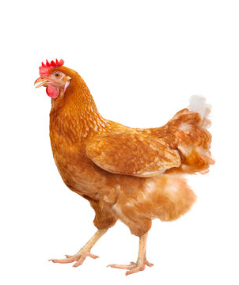
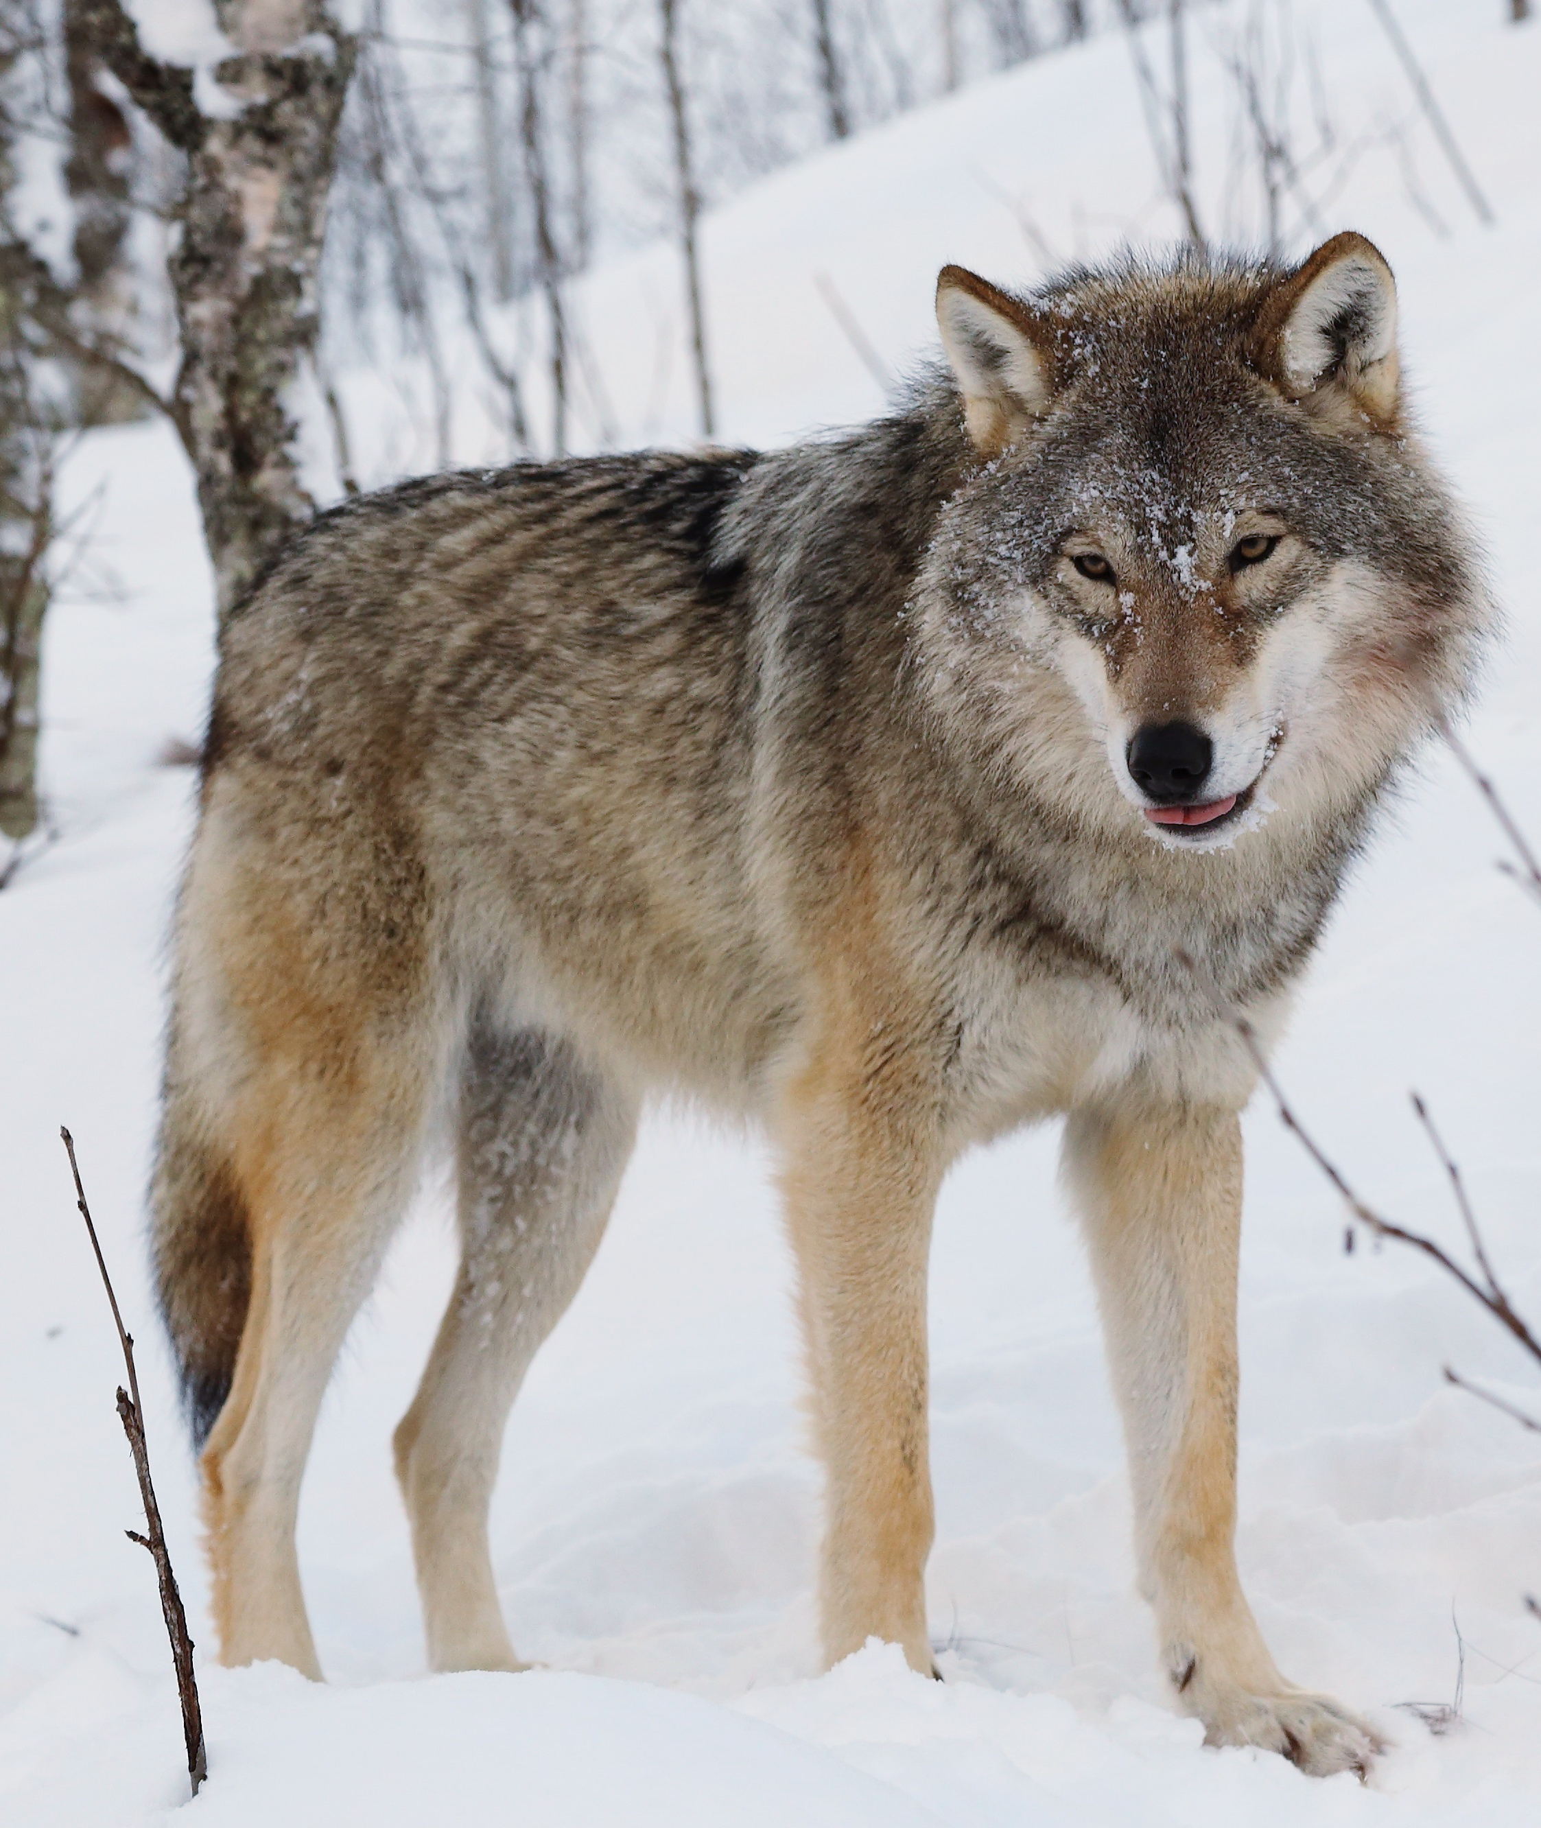
Introduction
Image classification task: Chicken vs Non-Chicken
Models used: VGG16 and ResNet50

Slide 3
Overview of Models
VGG16
Convolutional Neural Network
Computationally heavy, 138M parameters
Slower to train compared to modern architectures
ResNet50
Part of Residual Network Developed by Microsoft
Convolutional Neural Network
Less computational heavy, 25M parameters
Uses skip connections

Slide 4
Dataset and Preprocessing
Dataset details
Images gathered from Roboflow
Roughly 500 chicken and non-chicken photos to train on
Roughly 150 chicken and non-chicken photos to test on
Preprocessing steps
Rescaling image pixel values to 0-1
Resizing images to 224x224
Created bates for the model to train with
Used Binary classes
Shuffled training data for random distribution
Used distinct training/testing datasets

Slide 5
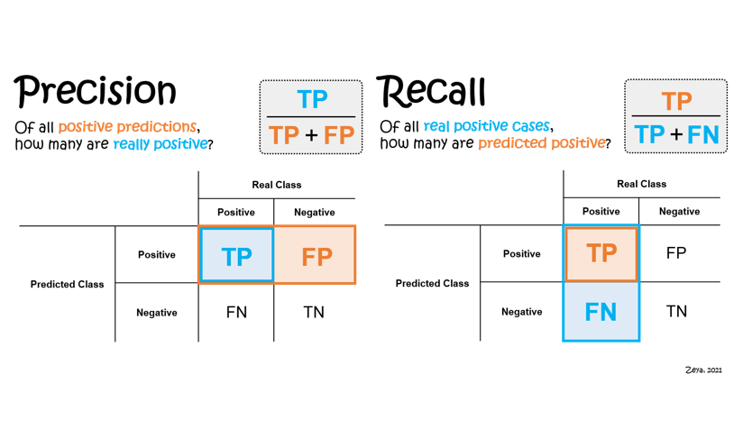
Evaluation Metrics Explained
Precision
Making sure everything predicted is correct
Recall
Making sure we’ve predicted everything
F1-Score
Balance between picking correctly and picking everything that’s correct
Accuracy
Overall correctness of our predictions
Notes:
Precision: I have 10 picks to get apples out of a basket. If all 10 picks are apples my Precision is perfect
Recall: I know there are 10 apples in the basket and if I pick all 10 my recall is perfect.
F1-Score. How well can I pick apples without picking other fruits, while at the same time not missing any apples?
Accuracy: Overall accuracy of how many choices I got right
Precision=TP+FPTP​
Recall=TP+FNTP​
F1-Score=2×Precision+RecallPrecision×Recall​
Accuracy=TP+TN+FP+FNTP+TN​

Slide 6
VGG16 Model Performance
VGG16 Model Performance:
Class 0 (Chicken): Precision: 100%, Recall: 64%, F1-Score: 78%
Class 1 (Non-Chicken): Precision: 79%, Recall: 100%, F1-Score: 88%
Overall Accuracy: 85%
Training time: 115.95 minutes
Test time: 3.6 minutes

Slide 7
ResNet50 Model Performance
Class 0 (Chicken): Precision: 90%, Recall: 36%, F1-Score: 52%
Class 1 (Non-Chicken): Precision: 67%, Recall: 97%, F1-Score: 79%
Overall Accuracy: 71%
Training Time: 47.46 minutes
Test time: 1.2 minutes

Slide 8
Comparative Analysis
Class 0 represents chickens, Class 1 represents non-chickens
VG116
Class 0: Precision 1.00, Recall 0.64, F1-score 0.78
Class 1: Precision 0.79, Recall 1.00, F1-score 0.88
ResNet50
Class 0: Precision 0.90, Recall 0.38, F1-score 0.52
Class 1: Precision 0.67, Recall 0.97, F1-score 0.79
ResNet50 was 2.44x faster to train and 3x faster to test
Notes:
VG116 is more balanced and effective overall, with good Precision and Great Recall on Class 1.
VG116 115.95
ResNet50 47.46666666666667

Slide 9
Conclusion and Recommendations
Summary of findings
Cost of missing or mis-identifying a non-chicken can be high
Cost of missing or mis-identifying a chicken is low
Recommendations
Implement both VG116 and ResNet50 in current state.
Refine parameters of ResNet50 for standalone implementation
Notes:
Cost of missing or mis-identifying a non-chicken can be high as this could mean a racoon, coyote, or other animal is near the chickens and could kill them. For this reason, we would want to focus on a model that has a high Recall of Class 1. Out of the box, VG116 would provide the better solution due to its better scoring of Class 1; however, ResNet50 provides a superior speed benefit compared to VG116.
The recommendation here is to implement both models in the beginning as ResNet50 could act as an early warning system, and VG116 can provide secondary confirmation. Second recommendation is to tune the parameters for ResNet50 to perform better so that it can stand on its own. Having a fast, and accurate, model would be preferred to having two models to maintain.

